Slide 1
Rag Enhanced Image Classification
Computer Vision
Myrto Potamiti, Panagiotis Korovesis, Giannis Fourfouris

Slide 2
Content
Overview
Dataset
Embeddings Generation
Brute Force KNN
Vision Transformer Predictions
Prediction using Function
Best Models Comparison
Conclusion
Notes:
We will begin with an overview of our approach and the dataset used for our experiments. N
Next, we will discuss how we generate embeddings for the memory and discuss the k nearest neighbor's retrieval method.
We will then present our prediction approach, which combines a weighted distance function with Vision Transformer SoftMax predictions.
Finally, we will compare the best models from each method and discuss our findings.

Slide 3
Overview
How can RAG Improve Image Classification?
By creating image embeddings from the train set.
By retrieving the most similar embeddings to help us with the classification.
How can KNN search hep us achieve this?
KNN can provide us with the K most similar embeddings for a given image.
How can we combine the results?
By applying a prediction function that gives a “weight” to each fetched embeddings original class
Notes:
The problem we are going to talk about is how can we improve an image classification task using RAG.
The main idea is to create image embeddings from the train set
For each test image, retrieve the most similar embeddings and use them in the classification
How can KNN search help us with this task
KNN can accurately give us the top K similar embeddings. This however works only on small volumes of data. Larger volumes require more efficient search algorithms such as FAISS search.
How can we combine the results?
We can apply a special formula that helps us combine:
The prediction
The classes of all the reteieved embeddings, with a weight depending on the similarity with the test image.

Slide 4
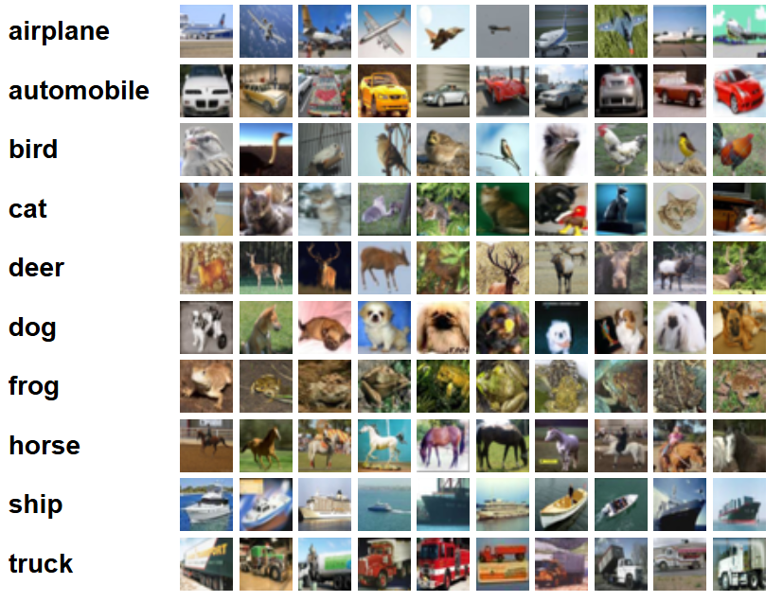
Dataset
CIFAR-10 Dataset:
Total Images: 60,000
Image Size: 32×32 pixels
Number of Classes: 10
Images per Class: 6,000
Training Set: 50,000 images
Test Set: 10,000 images
Notes:
The dataset we used for our experiments is the CIFAR-10 dataset. It consists of 6000 images at image resolution 32 by 32 pixels. It has 10 classes which we can see their labels on the figure on the right along with some sample images and 6000 images per clas. The training set consists of 50000 images and the test set of 10000 images.

Slide 5
Embeddings Generation (1/2)
For this method to work, good embeddings are a must
We have to use a pretrained SOTA vision model such as a Vision Transformer to extract the embeddings.
There are two approaches we can follow.
First Approach
Use the CLS token for each image
The CLS token provides a representation of the whole image
Second Approach
Use the patch embeddings
Each embedding characterizes a patch of the original image.
We must calculate a class for each patch of the test image and then decide on the final class
Notes:
In order for this method to work, good embeddings are everything.
We have to use a pretrained SOTA vision model such as a Vision Transformer to extract the embeddings
The first approach is to get the produced cls token for each image, as it contains a representation of the whole image
The second approach is to get the produced patch embeddings.
Each one characterizes a patch of the original image
This requires some modifications as we have to do the same for the test images and calculate a class for each patch of the test image. We then have to somehow decide the final class.

Slide 6
Embeddings Generation (2/2)
Model
vit_tiny_patch16_224 was our embeddings model
Developed by Google.
Trained on ImageNet
Creates embedding with a length of 192.
It splits each image into 196 patches.
CLS Method
Entire Train set as “Memory”.
One (CLS) embedding per train image.
Shape: (num_images, 192)
Patch Method
10% of Train set as “Memory”.
196 patch embeddings per train image.
Shape: (num_images, 196,192).
Notes:
We chose vit_tiny for the embeddings generation task.
1. This model is developed by google and originally trained on the ImageNet Dataset.
2. The embeddings produced have a length of 192
3. Each CIFAR10 image is split into 196 patches
For the CLS Method, we used the entire train set as our memory.
We generated one embedding (the cls token) per train image
The final shape of the memory was (num_images, 192)
For the Patch Method we used 10% of the train set as memory
196 patch embeddings were generated per train image
The final shape of the memory (num_images, 196,192)

Slide 7
Brute Force Only (1/2)
Acts as our baseline
We did not use any model, only a KNN Search.
CLS Method
The final image class was set to the majority class of the K neighbors
Patch Method
A class for each image patch was generated. (Same method as CLS)
The majority class of the patches was set to the final image class.
Notes:
To test the effect of the embeddings on this image classification task, we need a baseline.
To do this we are going to use KNN Search.
Two baselines will be established, one using CLS and one using the Patch Method.
Reminder: The neighbors will be fetched based on their embeddings similarity.
For the CLS, the predicted class for a test image will be the majority class of the K returned neighbors
For the Patch method
A class for each patch of the test image using the same method as the CLS
The predicted class will be the the most common class along the patch classes

Slide 8
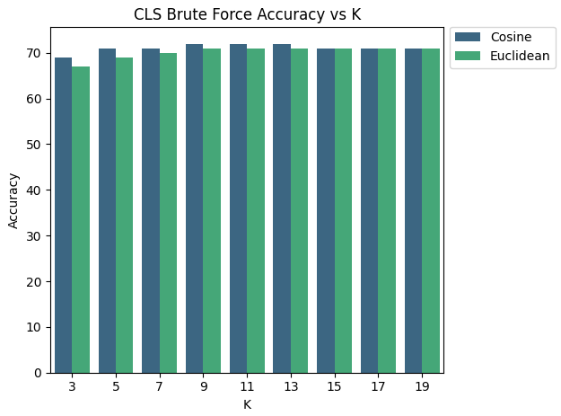
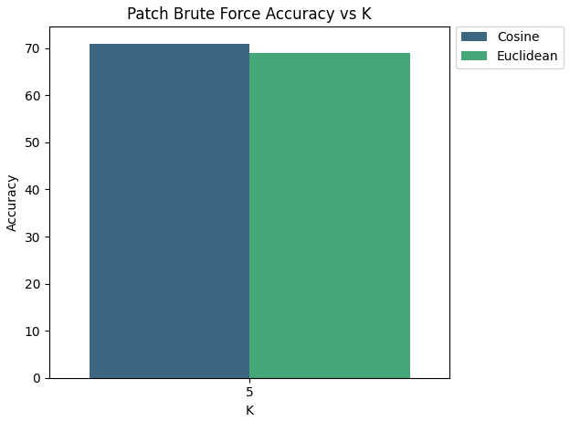
Brute Force (2/2)
Similar Performances between Euclidean and Cosine Distances
CLS Baseline: 72% Accuracy with Cosine, K=11. Patch Baseline: 71% Accuracy with Cosine.
Notes:
Now let’s take a look at the Brute Force Results.
Again, those are computed without any predictions, KNN only
For the CLS Method, Cosine gives consistently better scores, although the difference is minimal
The best accuracy is 72% with K = 9 or 11 or 13
For the Patch Method we only run two experiments with K = 5 due to hardware restraints.
Any larger K would result in out of memory exceptions when trying to store the neighbors (which is required for the second method)
Any larger memory would cause memory issues but also greatly increase the KNN run time
The best accuracy is 70% with the cosine distance.

Slide 9
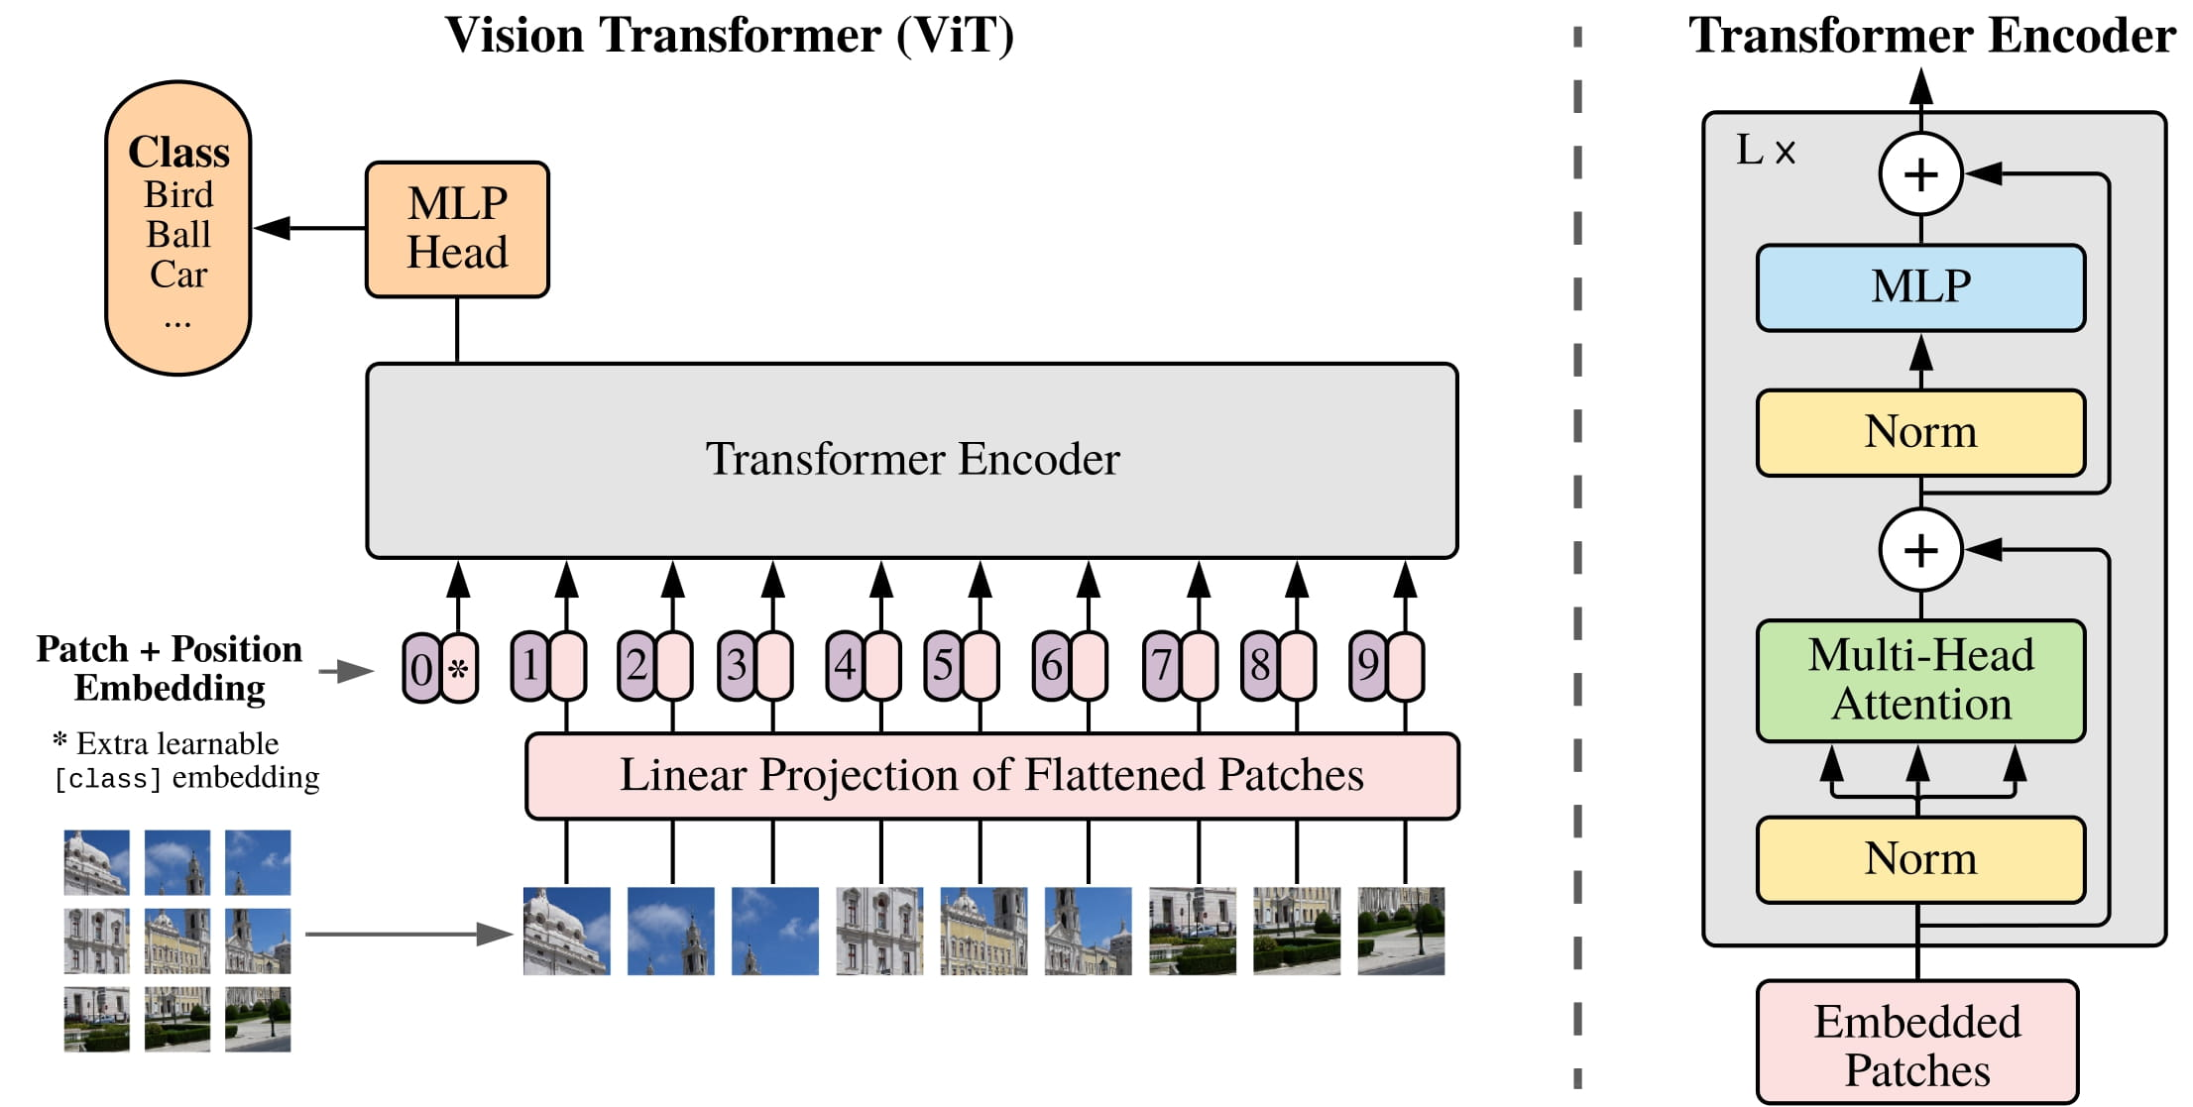
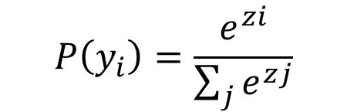
Vision Transformer Predictions
SoftMax Prediction Extraction
Model Training: ViT-Tiny fine-tuned on CIFAR-10, only the classifier head trained
Evaluation Process: During testing, model predicts class scores (logits)
SoftMax Calculation: Apply softmax to logits Probability distributions
Test accuracy: 76.77%
Softmax Predictions
Vision Transformer Architecture (ViT)
$$P\left(y_{i}\right)=\frac{e^{zi}}{\sum_{j}{e^{zj}}}$$
Class logit
Predicted softmax
Notes:
Besides using KNN to find similar images, we also use the Vision Transformer's predictions to improve classification.
We combine retrieved embeddings with softmax probabilities to make a final prediction using a weighted distance-base method.
To obtain the SoftMax predictions, we fine-tune only the classifier head of ViT-Tiny on CIFAR-10.
During testing, the model outputs class logits, which are raw prediction scores before SoftMax is applied.
These logits are produced in the MLP head, as shown in the Vision Transformer architecture diagram.
Instead of directly selecting the highest logit as the predicted class, we apply SoftMax to transform the logits into a probability distribution across all classes, following the SoftMax equation presented here.
The predicted class is the one with the highest probability, while the sum of all class probabilities equals 1.
Additionally, the model used for generating these SoftMax predictions achieves a test accuracy of 76.77%.

Slide 10
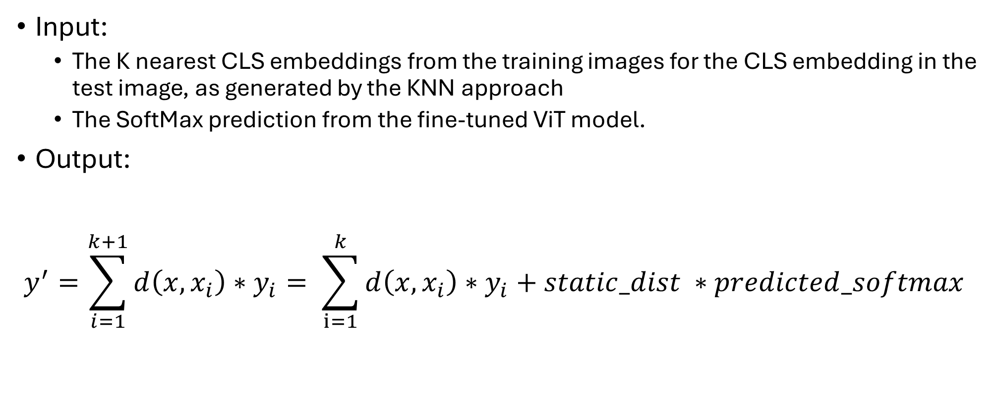
Prediction using Function – CLS Version (1/2)
Input:
The K nearest CLS embeddings from the training images for the CLS embedding in the test image, as generated by the KNN approach
The SoftMax prediction from the fine-tuned ViT model.
Output:
$$y^{′}=\sum_{i=1}^{k+1}{d\left(x, x_{i}\right)∗y_{i}= \sum_{i=1}^{k}{d\left(x, x_{i}\right)∗y_{i}+static_dist ∗predicted_softmax} }$$
Similarity
(test_image, k_nearest_image)
The one-hot vector representing the class of the k_nearest_image
Value representing a perfect match
Notes:
Moving forward, we also implemented a prediction method that we are going to describe. We have two versions: one using the CLS embeddings and one other using the patch embeddings. Here we describe the CLS version.
The input consists of two key components:
The K nearest CLS embeddings from the training images, selected for the CLS embedding of the test image using the KNN method presented by Panos .
Apart from that, we also use The SoftMax prediction vector from the fine-tuned Vision Transformer as showed by Myrto.
The output is computed as the sum of the similarities between the embeddings of the test image and the K nearest image embeddings each multiplied by the corresponding one-hot vector, representing the class of the k nearest image. This means that for each one of the K nearest neighbors, the similarity between test and nearest embedding​ is used to weight the contribution of its corresponding class label​. Additionally, the static distance, which represents a perfect match, is incorporated as an additional factor along with the predicted SoftMax vector. This approach combines both local similarities and the global prediction to refine the final output.

Slide 11
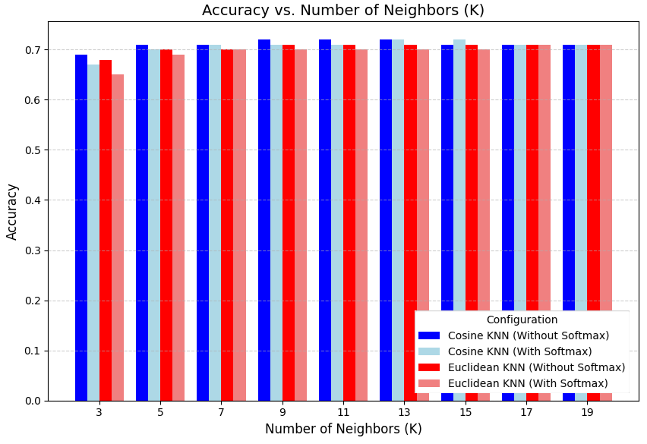
Prediction using Function – CLS Version (2/2)
Types of Experiments:
CLS embeddings produced with Cosine KNN vs Euclidean KNN.
Effect of SoftMax Predictions.
Testing different values of K.
For these experiments we focused on cosine similarity due to time constraints, but Euclidean similarity could also be explored.
Notes:
We conducted several types of experiments to evaluate the model's performance.
The first experiment compares the effectiveness of CLS embeddings obtained with Cosine KNN versus Euclidean KNN. This helps determine which distance metric yields better results when identifying the K nearest neighbors.
The second experiment explores the effect of SoftMax predictions on the final class label. This analysis investigates how incorporating the predicted SoftMax values influences the overall prediction when combined with the nearest neighbor information.
Finally, we test different values of K the number of nearest neighbors to assess how varying this parameter impacts the accuracy and robustness of the model.
Due to time constraints, the prediction function only uses the cosine similarity to determine how close the embeddings are, but Euclidean similarity could also be explored in future work.
From the plot, we observe that the embeddings produced by KNN with Cosine consistently outperform those created with Euclidean across all values of K and configurations (with or without SoftMax predictions). Accuracy improves as K increases, peaking around K=9 or K=11 before slightly decreasing due to irrelevant neighbors. Surprisingly, incorporating SoftMax predictions results in slightly lower accuracy in some cases compared to not using them, despite the base model having ~76% accuracy. The best configuration achieved 72% accuracy, which is lower than the fine-tuned model's performance, indicating that while the function-based approach is reasonable, it is not as effective. The prediction-with-function approach underperforms compared to the base model (~76% accuracy), suggesting either that the embeddings are not ideal for the function or that the function prediction method needs refinement, such as better distance weighting or neighbor selection.

Slide 12
Prediction using Function – Patch Version (1/2)
Input:
Like before, but now the K nearest Patch embeddings from the training images are retrieved for each Patch embedding in the test image.
Output:
Class scores from each patch embedding are computed and then summed or averaged to identify the class.
Notes:
Apart from CLS embeddings, we also examined patch embeddings. In this version, the input consists of the K nearest patch embeddings from the training images, selected for each patch embedding in the test image. These embeddings are retrieved using the same KNN approach but applied at the patch level, identifying the nearest neighbors for each individual patch.
So the function is calculated for each one of the test image patch embeddings and then we sum or average each individual score vector across all patches to derive the final class label. This method leverages local information from individual patches to refine the overall prediction. As before, the static distance factor is incorporated alongside the predicted SoftMax label.

Slide 13
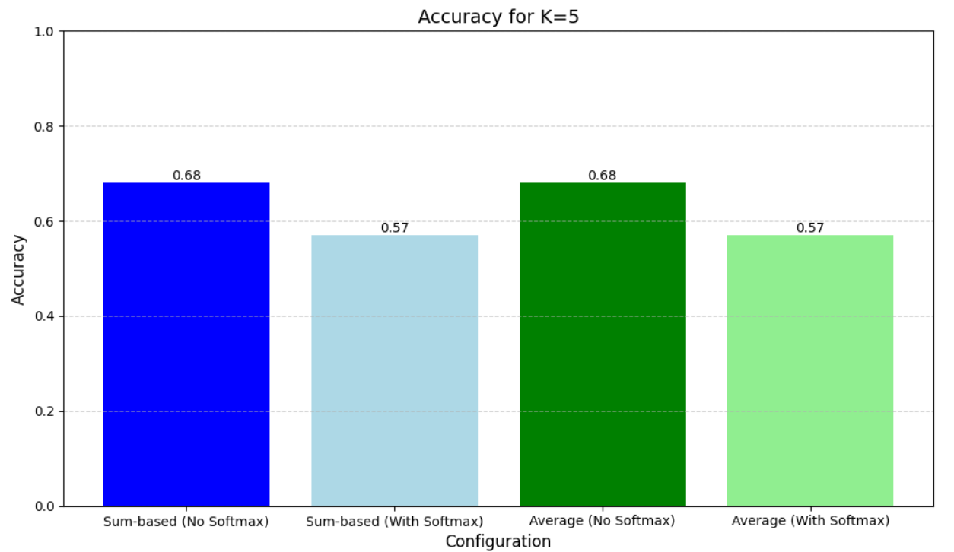
Prediction using Function – Patch Version (2/2)
Types of Experiments:
Patch embeddings produced with Cosine KNN.
Influence of different weighting strategies (Sum-based vs Average).
K = 5.
SoftMax Predictions Impact.
Notes:
For the patch embedding evaluation we examine only the patch embeddings that produced with Cosine KNN due to resources and time limitation. We also examine the impact of different weighting strategies, such as sum-based versus average, to assess their effect on accuracy. Due to resource constraints, we used K=5 neighbors for these experiments, along with the influence of SoftMax predictions.
The results show that incorporating SoftMax predictions reduces accuracy from 0.68 to 0.57, regardless of the weighting strategy. This suggests that SoftMax probabilities may be poorly calibrated or introduce noise when weighting nearest neighbors on the patch level, leading to a misalignment between predicted probabilities and the similarity-based approach, likely due to incorrect predictions. The choice between sum-based and average weighting has minimal impact, as both produce the same accuracy with or without SoftMax predictions. To improve performance, further investigation into SoftMax calibration, adjusting the static distance factor and exploring alternative distance metrics or a larger K value are recommended.

Slide 14
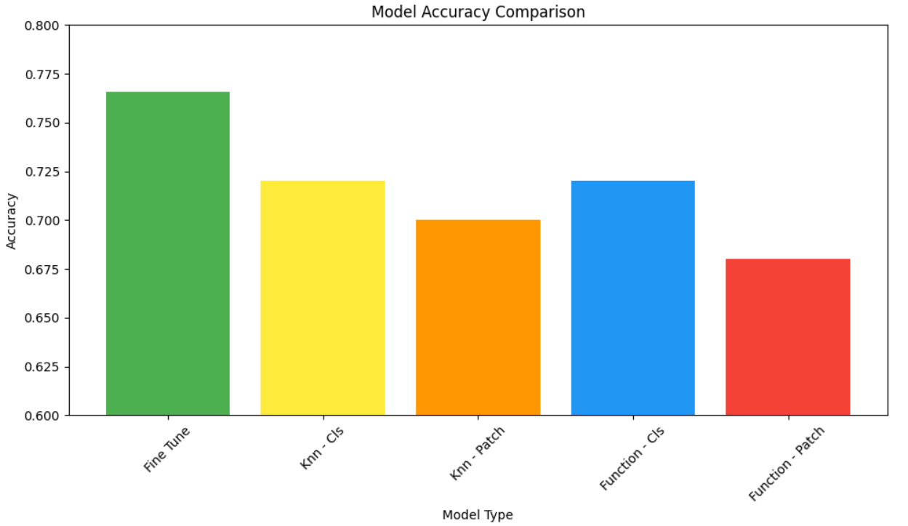
Best Models Comparison
Notes:
Fine-tuning the classifier head of ViT-Tiny achieves the highest accuracy of 0.7657, outperforming all other methods.
This indicates that training the model directly on the dataset enables it to learn better feature representations compared to alternative approaches.
Using brute-force KNN with CLS embeddings and cosine similarity achieves 0.72 accuracy for K values of 9, 11, and 13. However, when using patch embeddings instead, the accuracy slightly decreases, suggesting that while local patch-level information is useful, it may not be as discriminative as CLS embeddings for final classification. Additionally, the choice of weighting method, whether sum-based or average, does not significantly impact performance in the patch-based approach.

Slide 15
Conclusion
Fine-tuning ViT provides the best performance.
The brute force KNN performs similar to the Function prediction method.
CLS embeddings work better than patch-based embeddings.
Higher K values (9-13) improve KNN performance by reducing noise.
Using SoftMax weighting in previous experiments may have decreased the performance, but it needs further testing.
Notes:
Fine-tuning delivers the best performance, likely due to its ability to extract better features and adapt to the specific task. The brute force KNN has similar behavior with the prediction using the function. CLS embeddings prove to be more effective than patch-based embeddings for classification. In KNN, using higher K values (9-13) helps improve performance by reducing noise but up to a threshold. Finally, previous experiments using softmax weighting may have contributed to a decrease in performance, though further testing is needed to confirm this impact.

